Slide 1

Submitted by
Fazlee Rabby
Dept .of Software Engineering
Daffodil International University
Real Estate Management System
Submitted by
KM Abu Saim
ID:171-35-195
Rahul Roy
ID:171-35-204
Dept .of Software Engineering
Daffodil International University
18/03/2021

Slide 2
Table Of Contents
Introduction
Project Scope
Objectives
Project Prospective
Project Goal
Tools
Diagram
Design

Slide 3
Introduction
This Project is a Online real estate business website. where a user can access its information and manage all the adding, updating, deleting the assets and some of its tasks. User can buy and sell their property.

Slide 4
Project Scope
Now days when everything is online, how is it possible that real estate left web application behind. There are lot of real estate companies who advertise their property online so idea behind developing this application is that their property can also sell or buy using this website.
This website is a online real estate management through which individual seller or buyer can maintain their property & property document keeping and managing property registration and also access its information and manage all the updating.

Slide 5
Objectives
The system have a login. A login box should appear when the system is invoked.
The Admin should have all the type of authority.
The user can sell or buy the property with detail of property.
This system verify the property, who owner of property.

Slide 6
Project Prospective
Admin’s interface: Admin is a person who will handle the entire website. For that person has to give the user name and password to enter the admin page. After entering right password admin person can enter the admin home area. Here user buy different property & sell them to the system. Buyer user property & builder verify each-other & make reliable communication to each other.
User’s interface: User can visit the home page of real estate in which first the introduction of our site mention first. The registered user can login from the login module. Here guest can register free account to sell and buy property &buyer verify each other & make reliable communication to each other. User can search the property and it can select the type of property and its budget and also find the location of property.

Slide 7
Project Goal
Our main goal of this project we provide best service through our website.
Customer can contact real estate agent by this website.
We show recent popular estate in home page, where buyer can choose their desire property.
We also provide recent real estate market position News
Customer can search real estate their budge range.

Slide 8
Tools
Design
HTML
CSS
Bootstrap
Back-end
Django

Slide 9
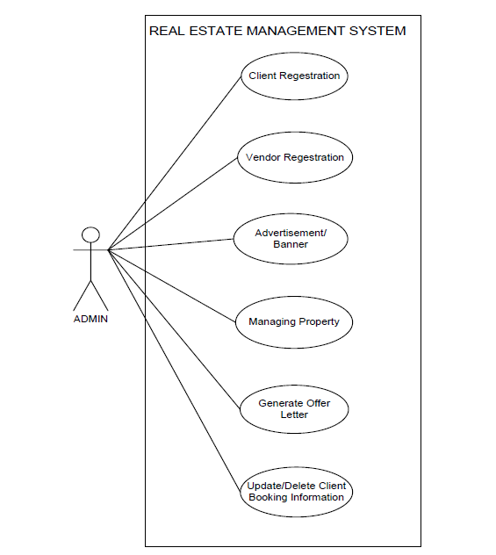
Use-Case For Admin

Slide 10
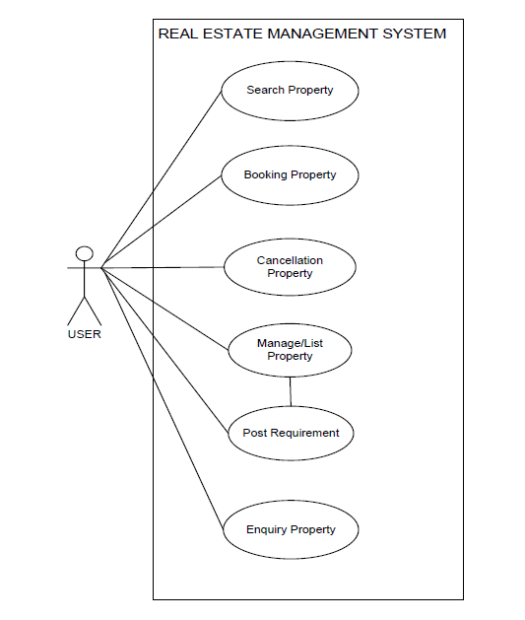
Use-Case For User

Slide 11
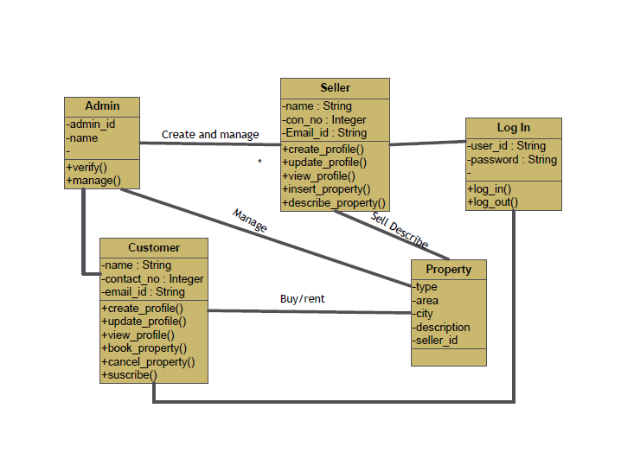
Class Diagram

Slide 12
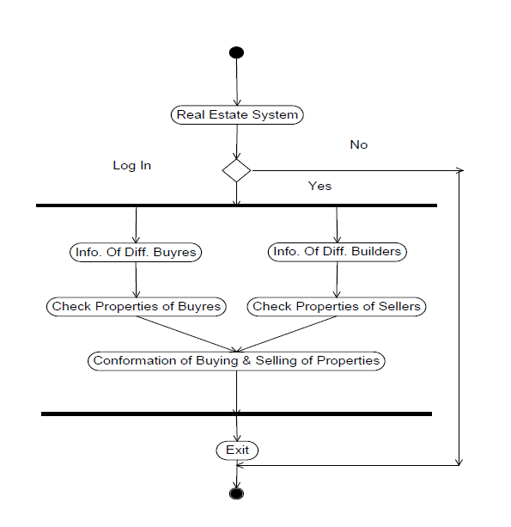
Activity Diagram

Slide 13
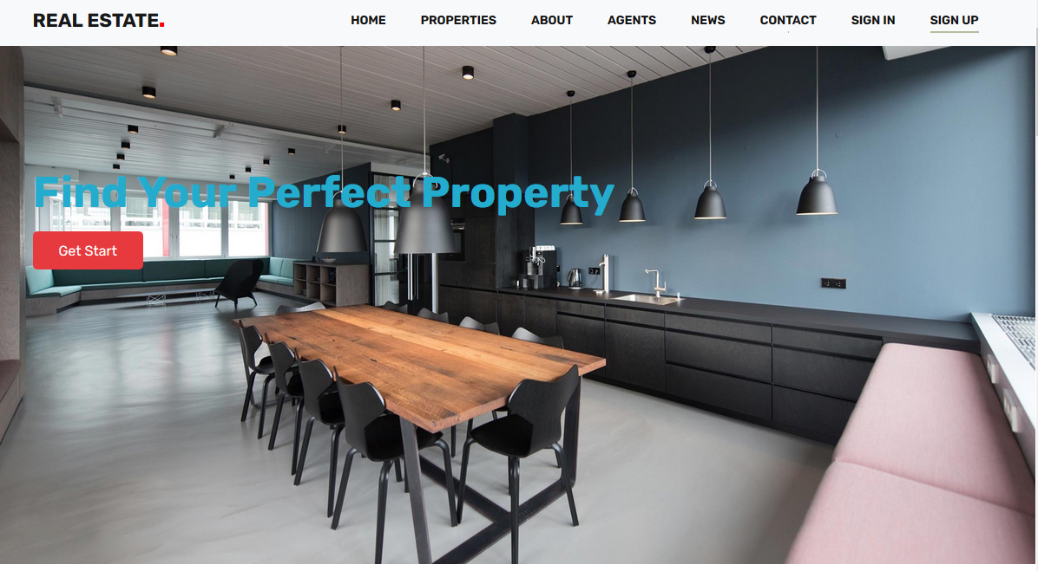
Home Page

Slide 14
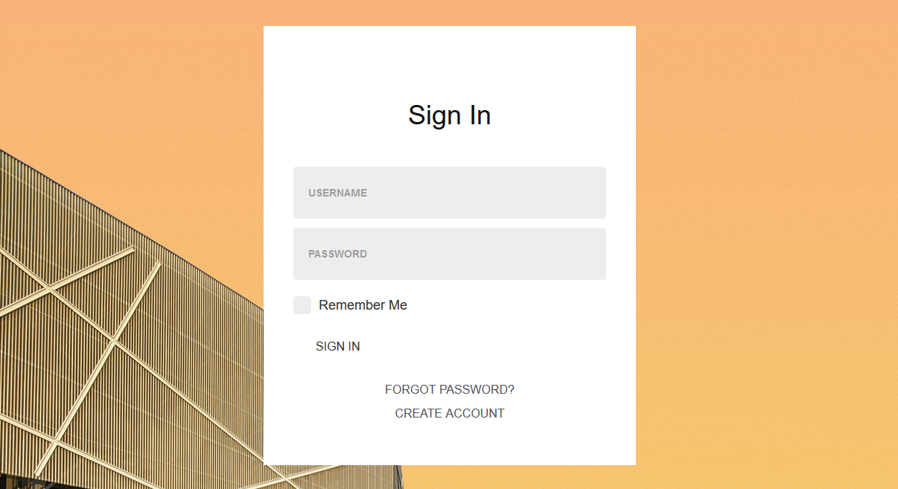
Sign in Page

Slide 15
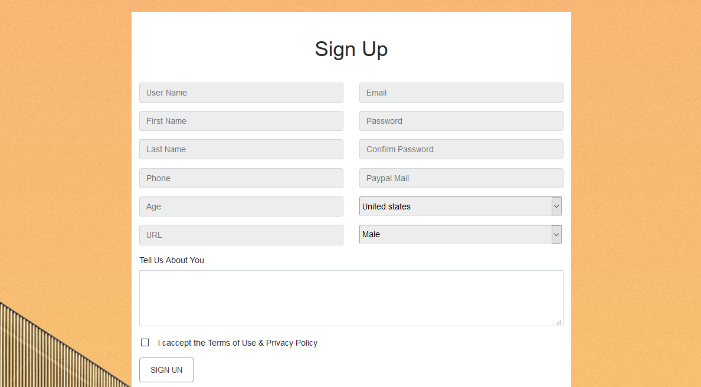
Sign Up Page

Slide 16
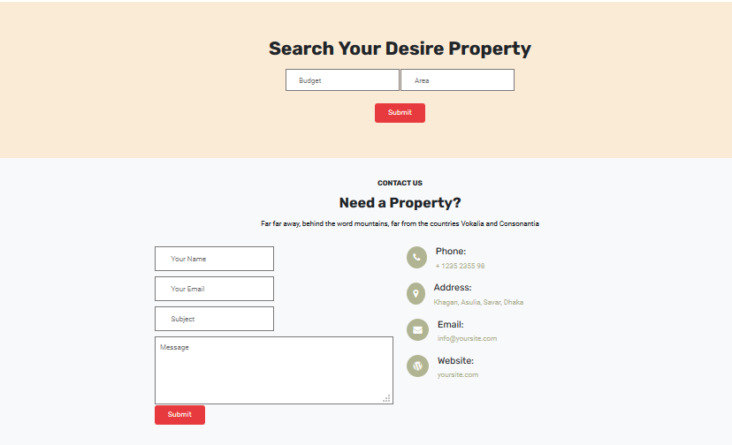
Search & Contact Page

Slide 17
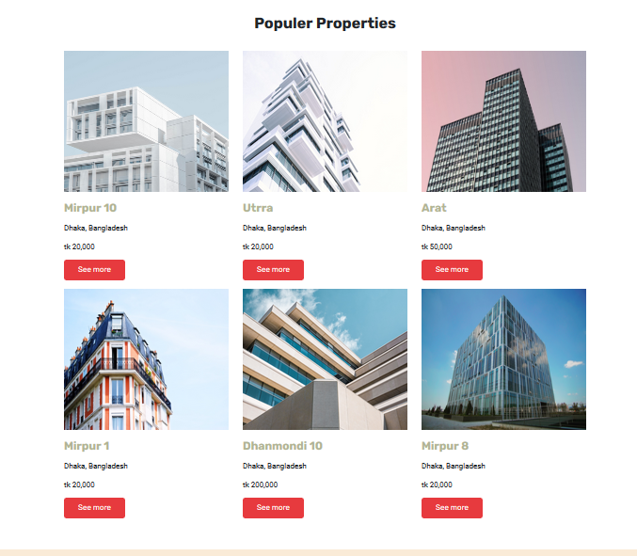

Slide 18
Thank You

